Slide 1
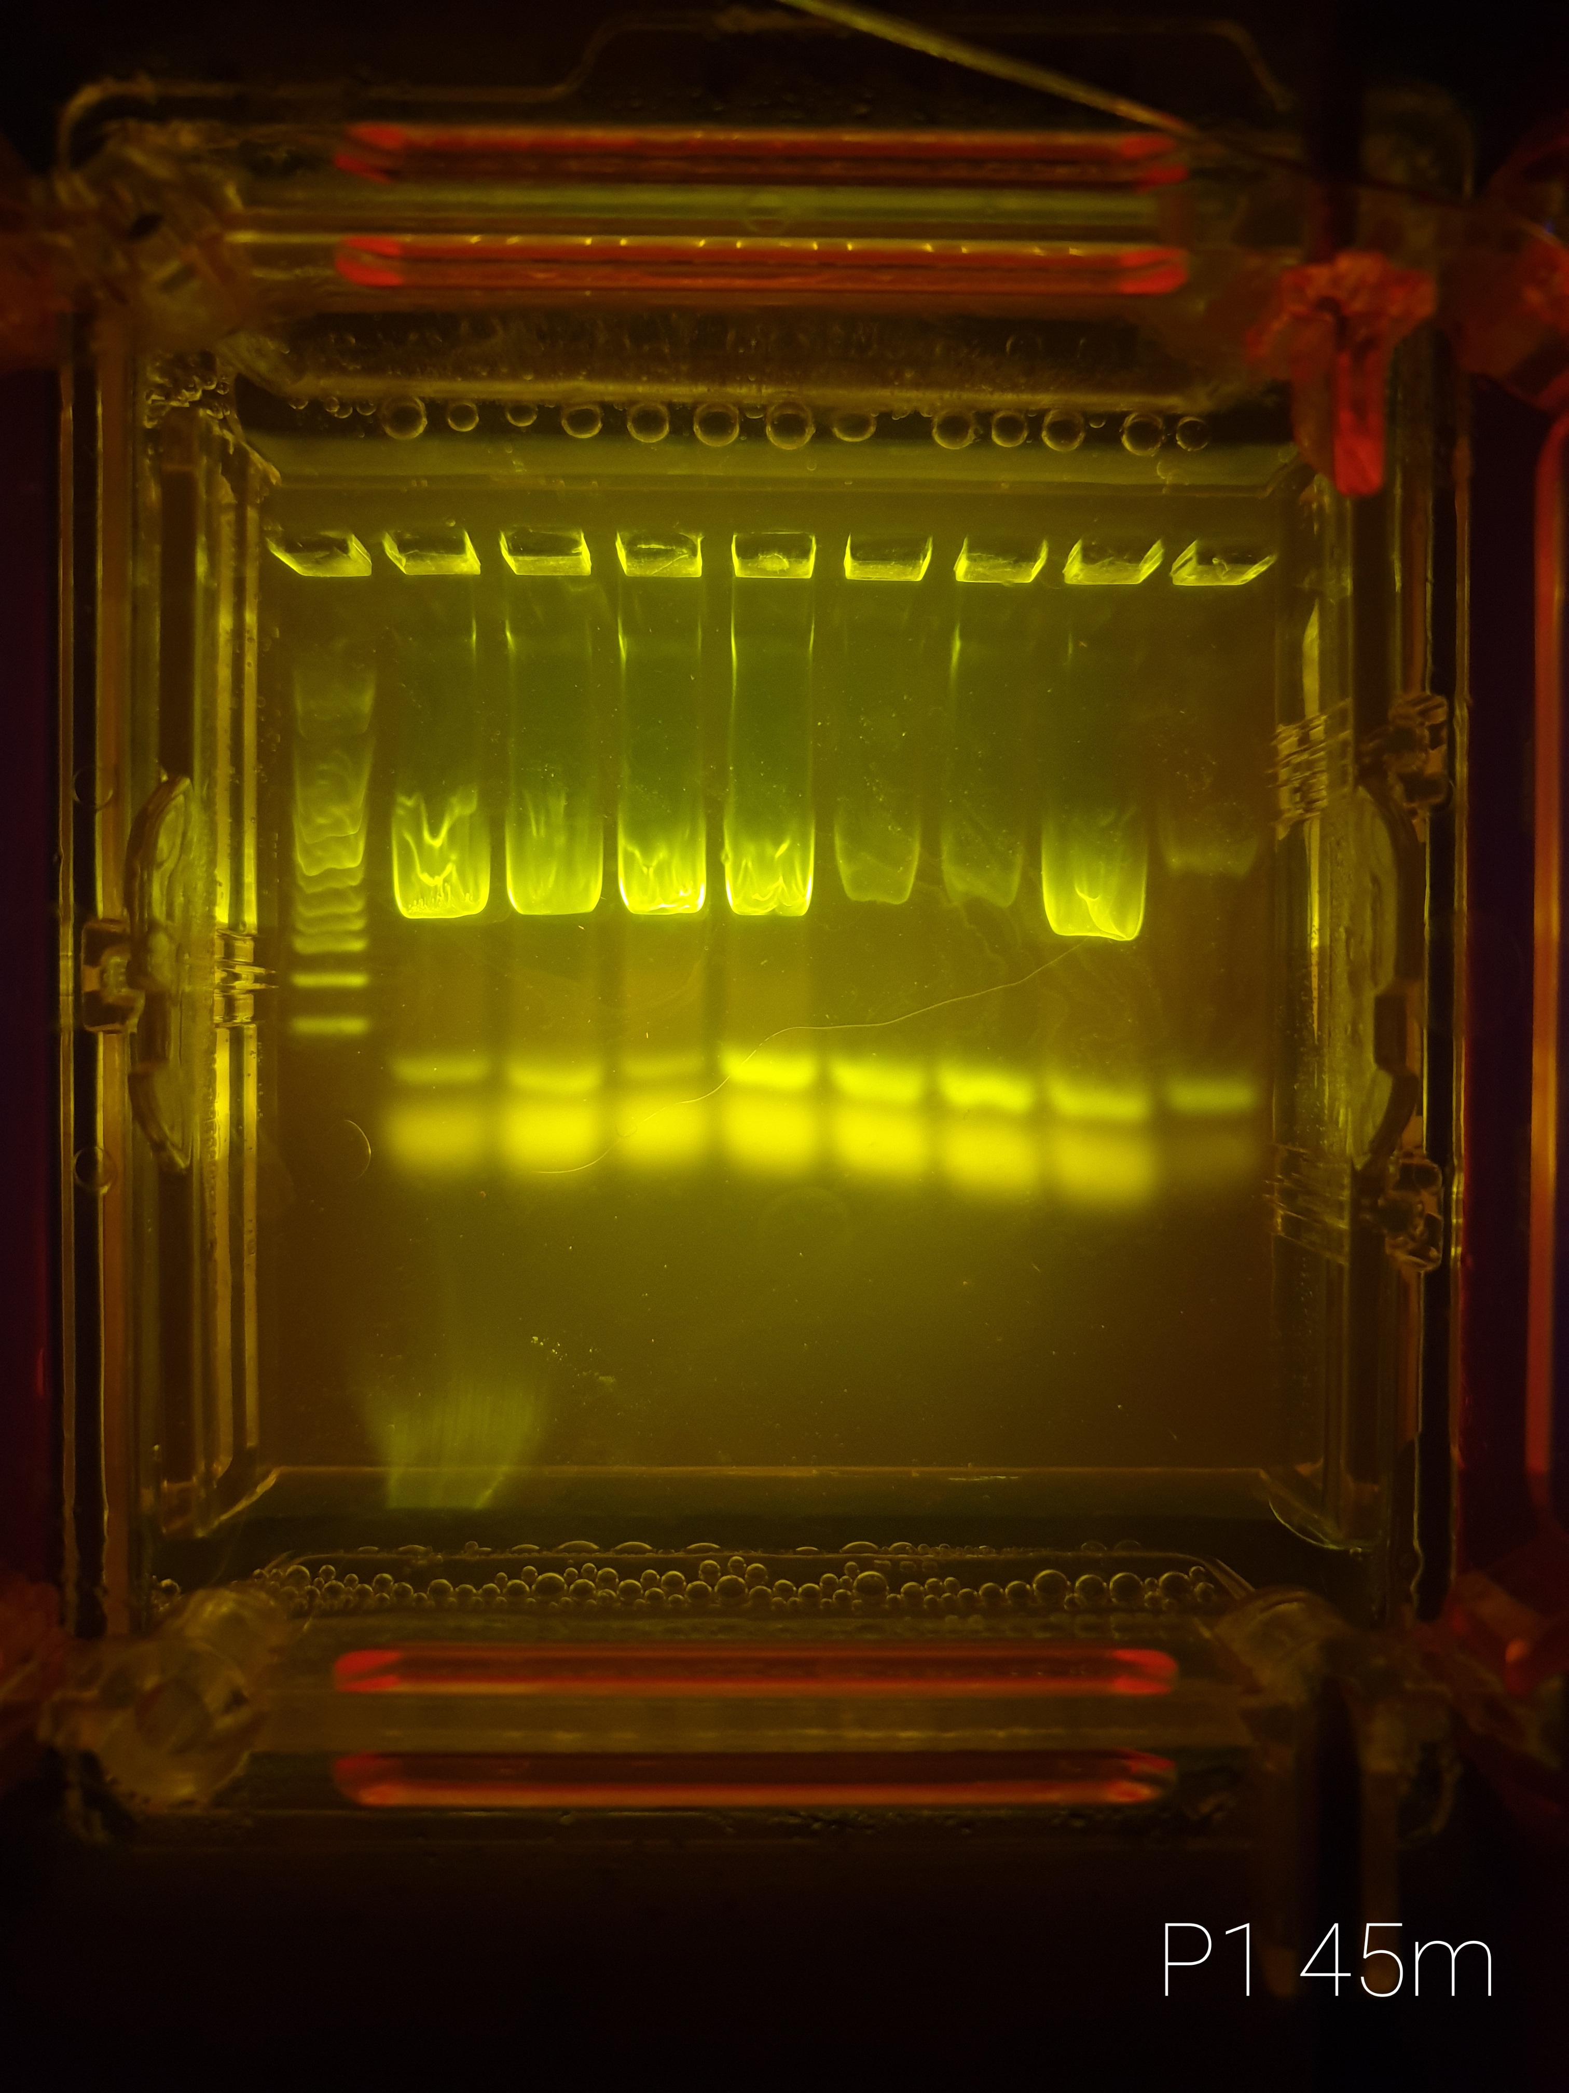
18 Dec Plate 1
1 | 2 | 3 | 4 | 5 | 6 | 7 | 8 | 9
Ladder | B7-T | D8-T | B10-T | D10-T | F10-T | G10-T | [7]B7-T | [7]F10-T
Differences in TEM presence between rescued & non-rescued
blaTEM begins in position 1 in the integron
Conveys resistance to aztreonam
Should theoretically only be present in non-rescued populations
That assumes 100% rearrangement

Slide 2
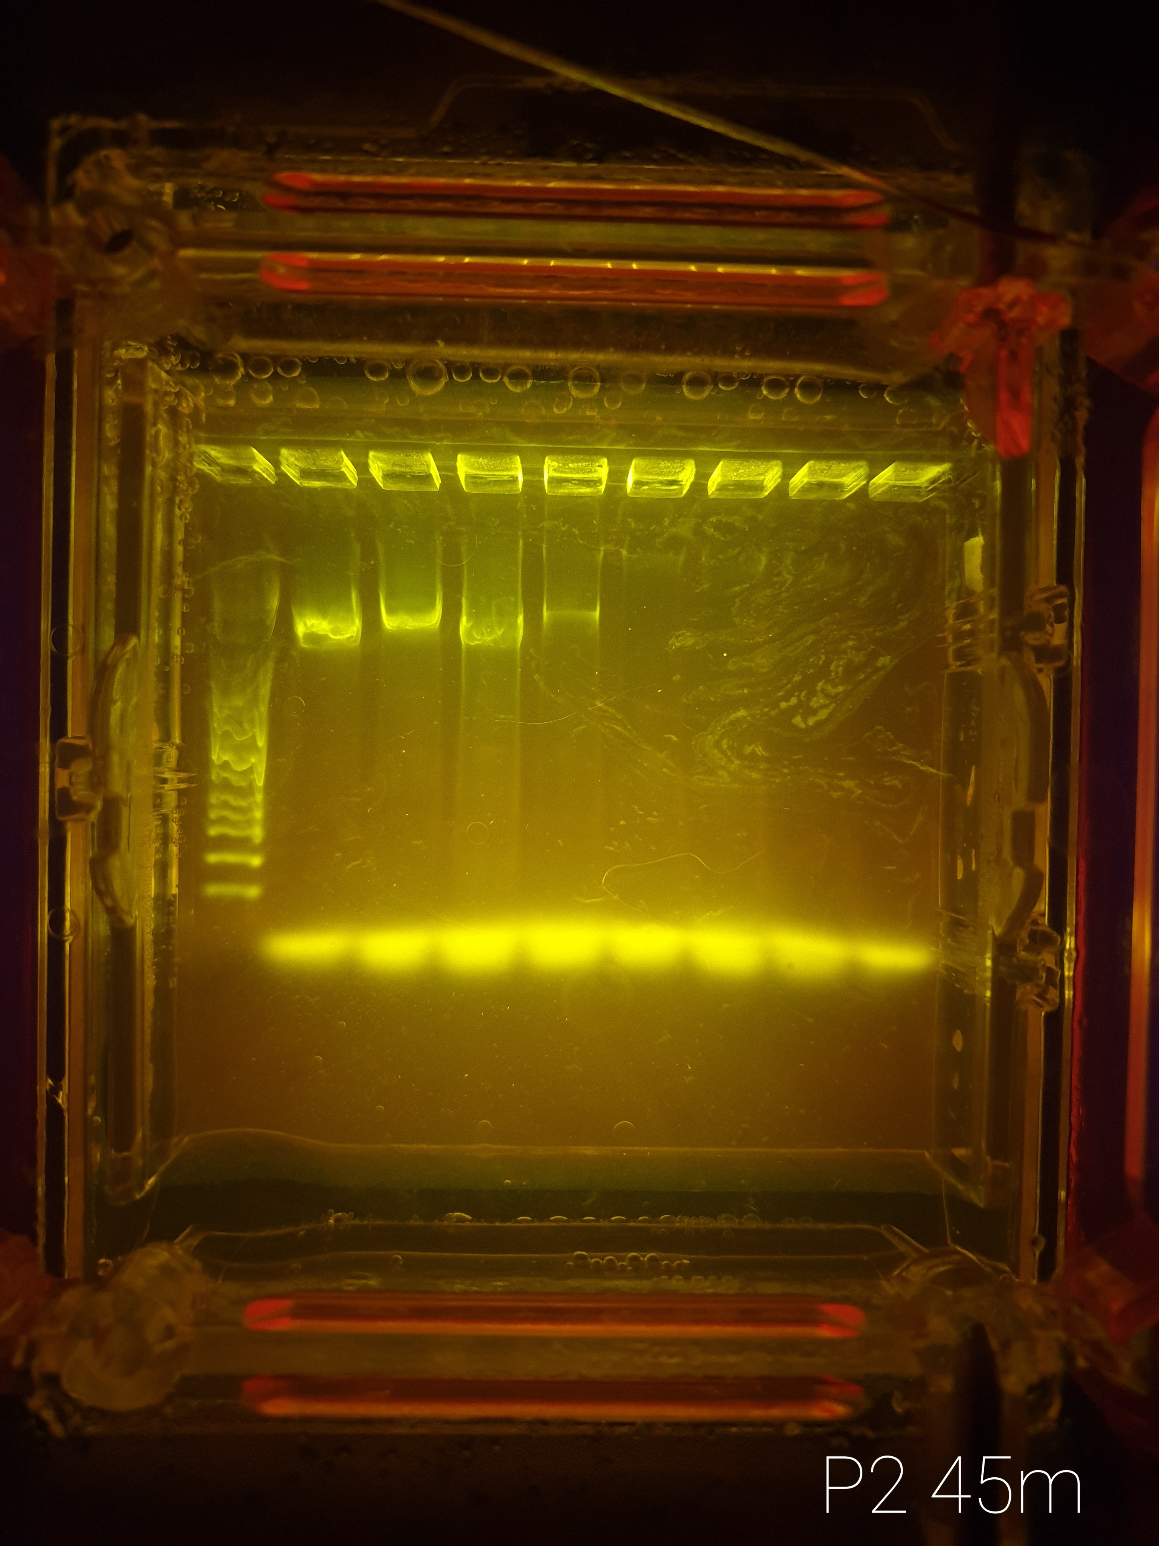
18 Dec Plate 2
1 | 2 | 3 | 4 | 5 | 6 | 7 | 8 | 9
Ladder | B7-V | D8-V | B10-V | D10-V | F10-V | G10-V | [7]B7-V | [7]F10-V
Differences in VIM presence between rescued & non-rescued
blaVIM begins in position 4 in the integron
Conveys resistance to imipenem (drug used)
Should only be found in rescued, non-rescue shouldn’t be able to rearrange their cassette order

Slide 3
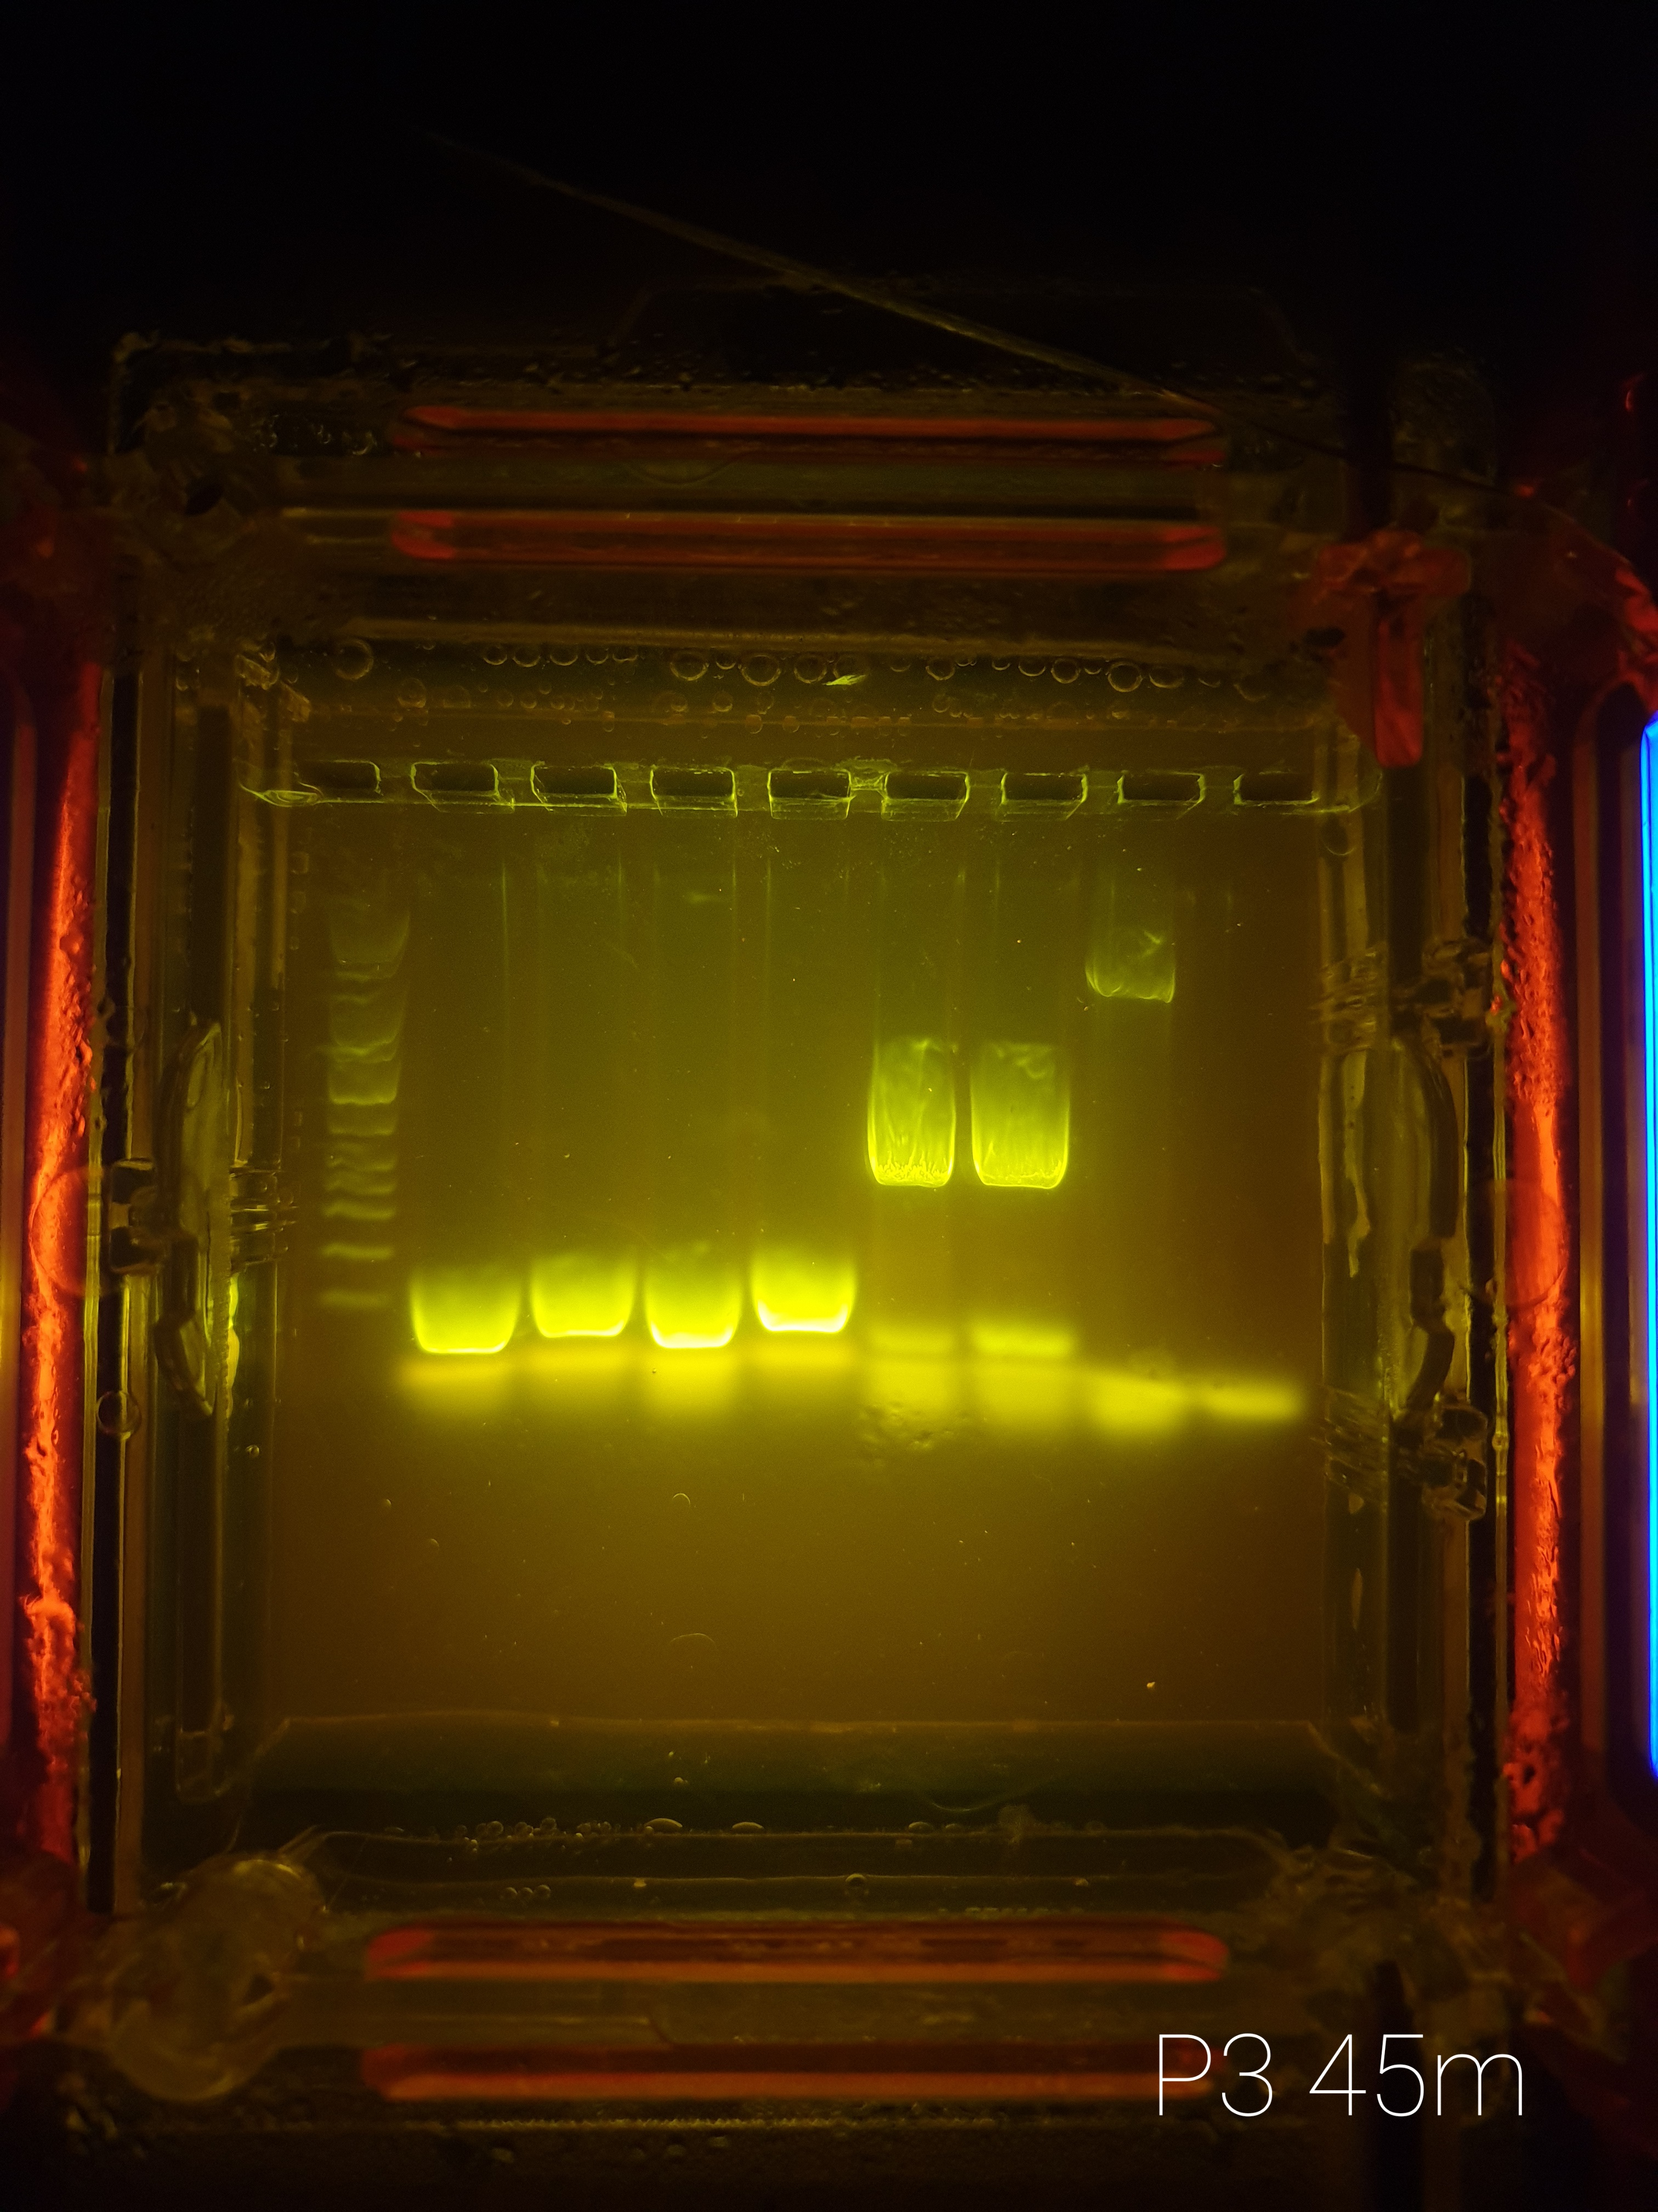
18 Dec Plate 3
1 | 2 | 3 | 4 | 5 | 6 | 7 | 8 | 9
Ladder | B7-S | [7]B7-S | F10-S | [7]F10-S | B7-T | [7]B7-T | B10-V | [7]B10-V
Confirmation for 16s AND plate differences
16s seems measurable in all samples, as it should be
Odd plate discrepancy for B10-V?

